Slide 1

C# 재고관리 프로그램
☞학번:2019875026
☞이름:박현수
☞발표일자 : 23/06/12
☞담당교수:김주현 교수님

Slide 2
◎목차
1.원본
2.Upgrade하기
3.출처

Slide 3
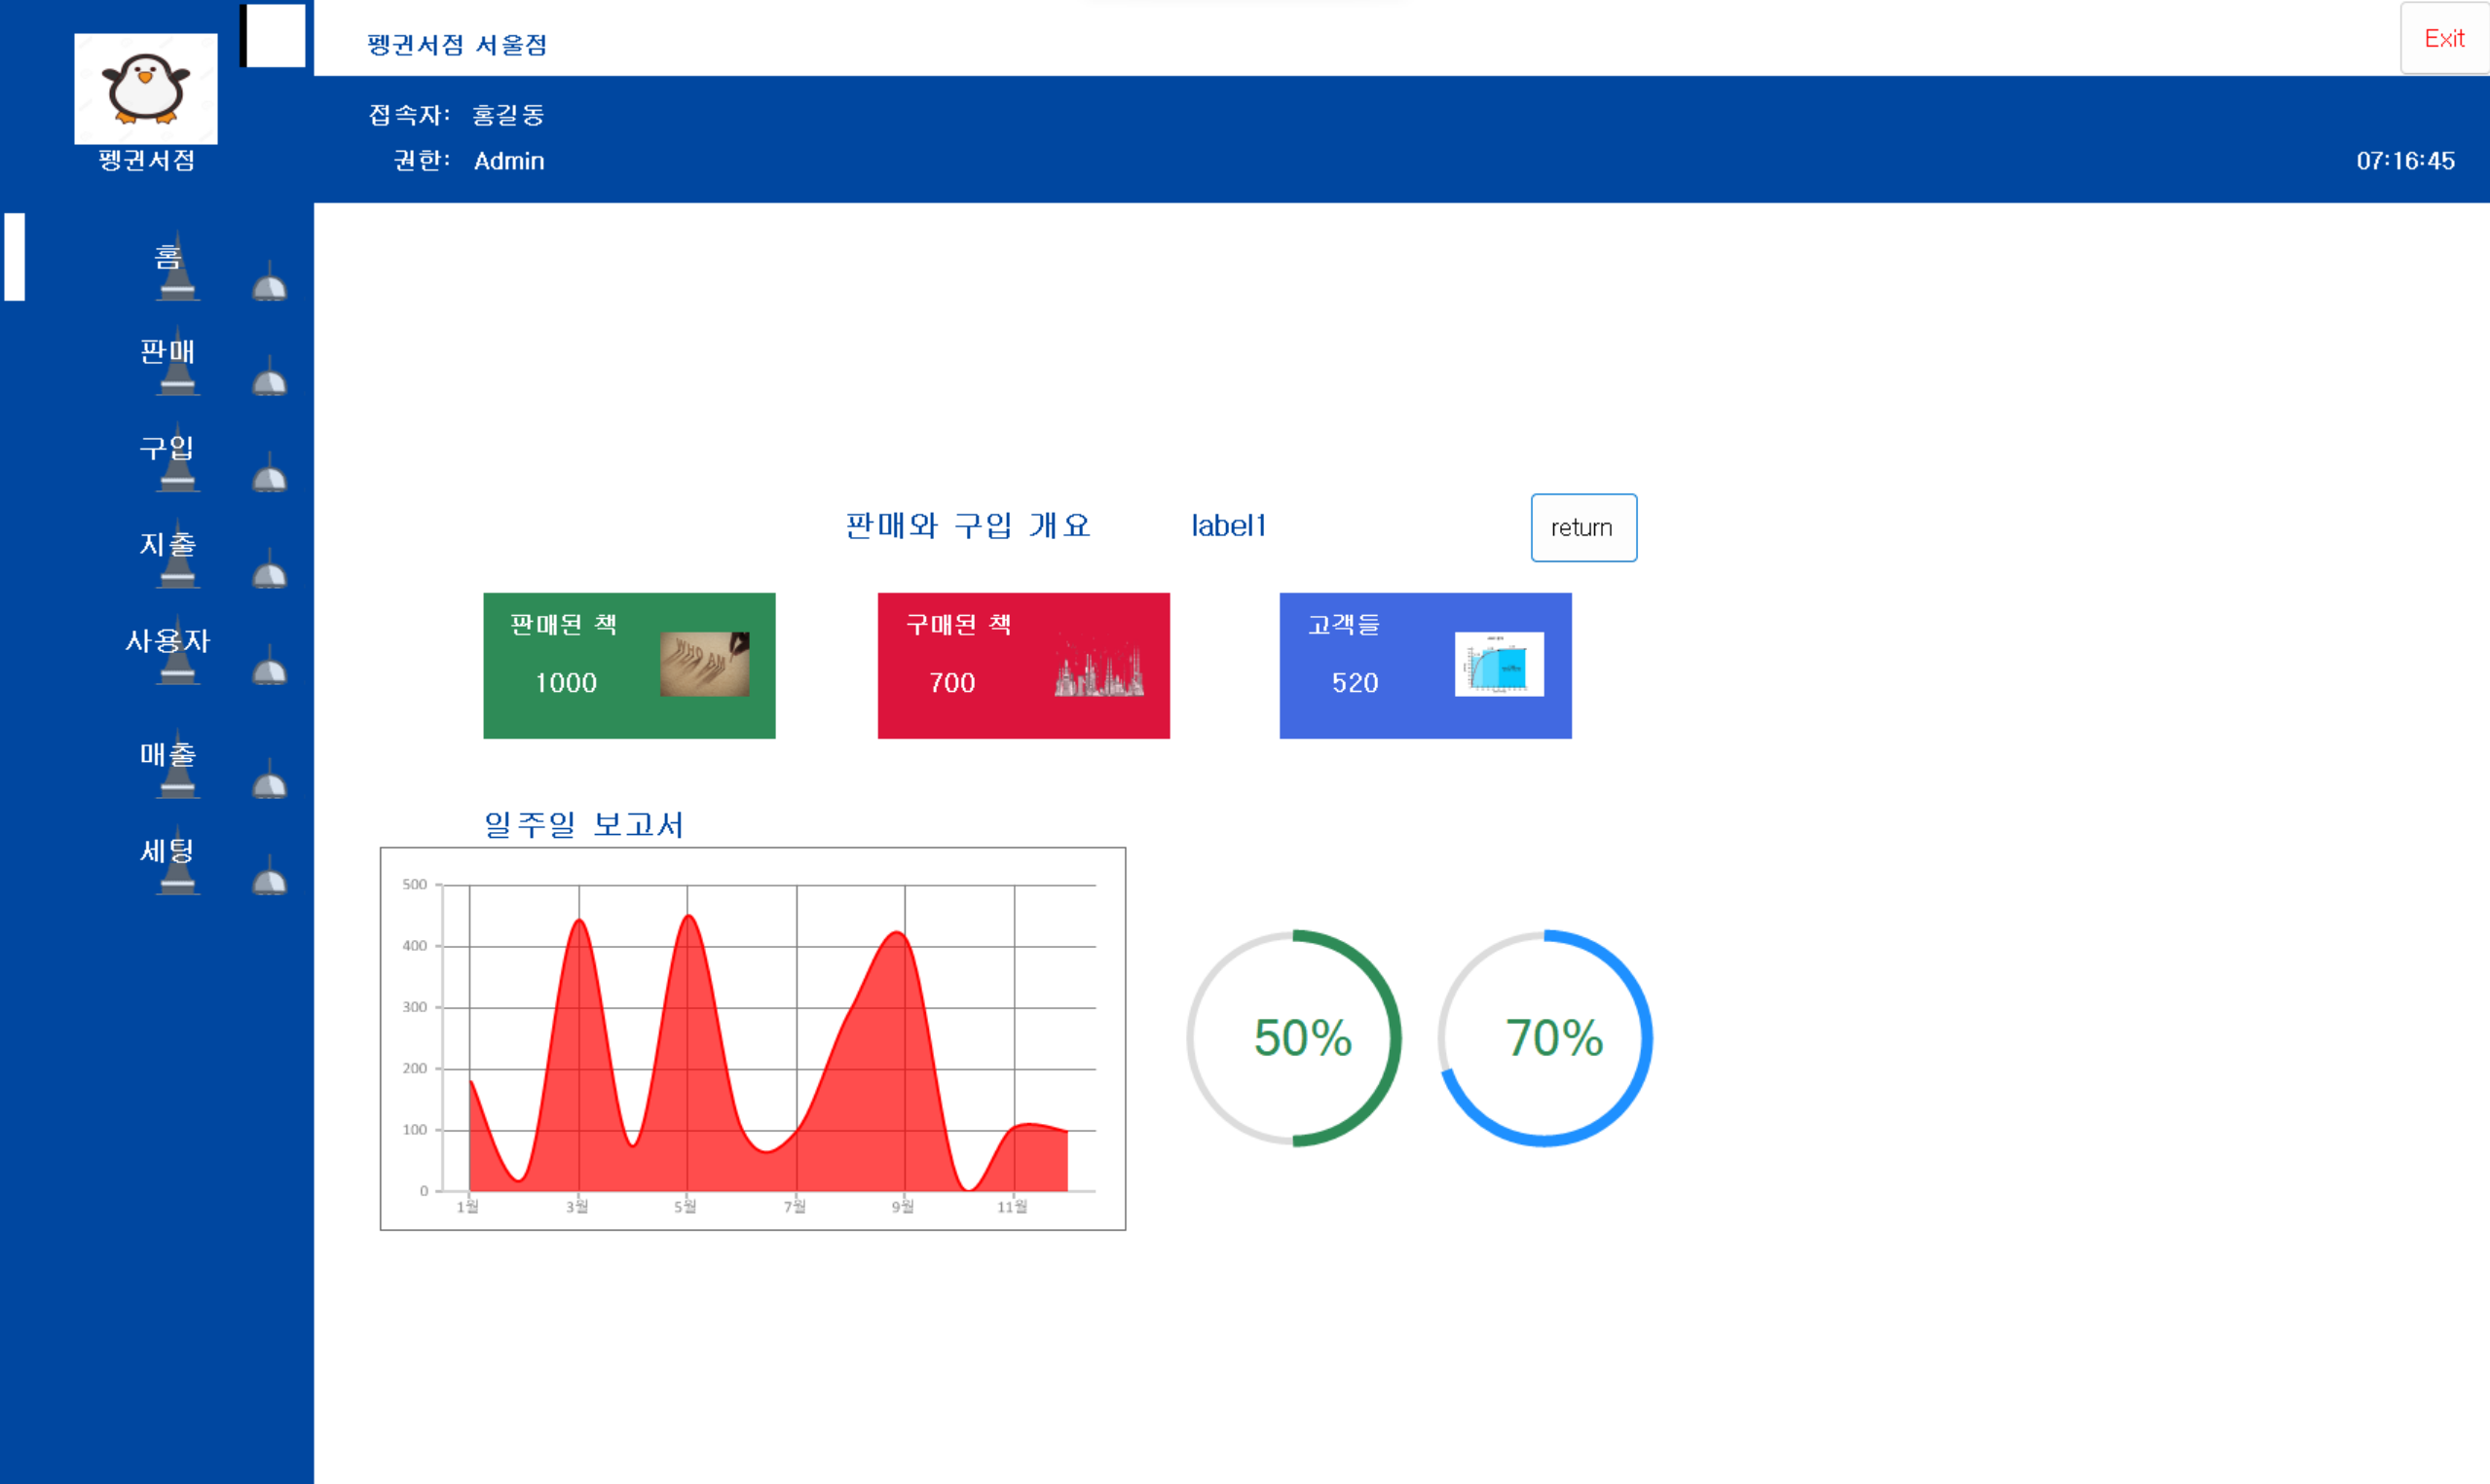
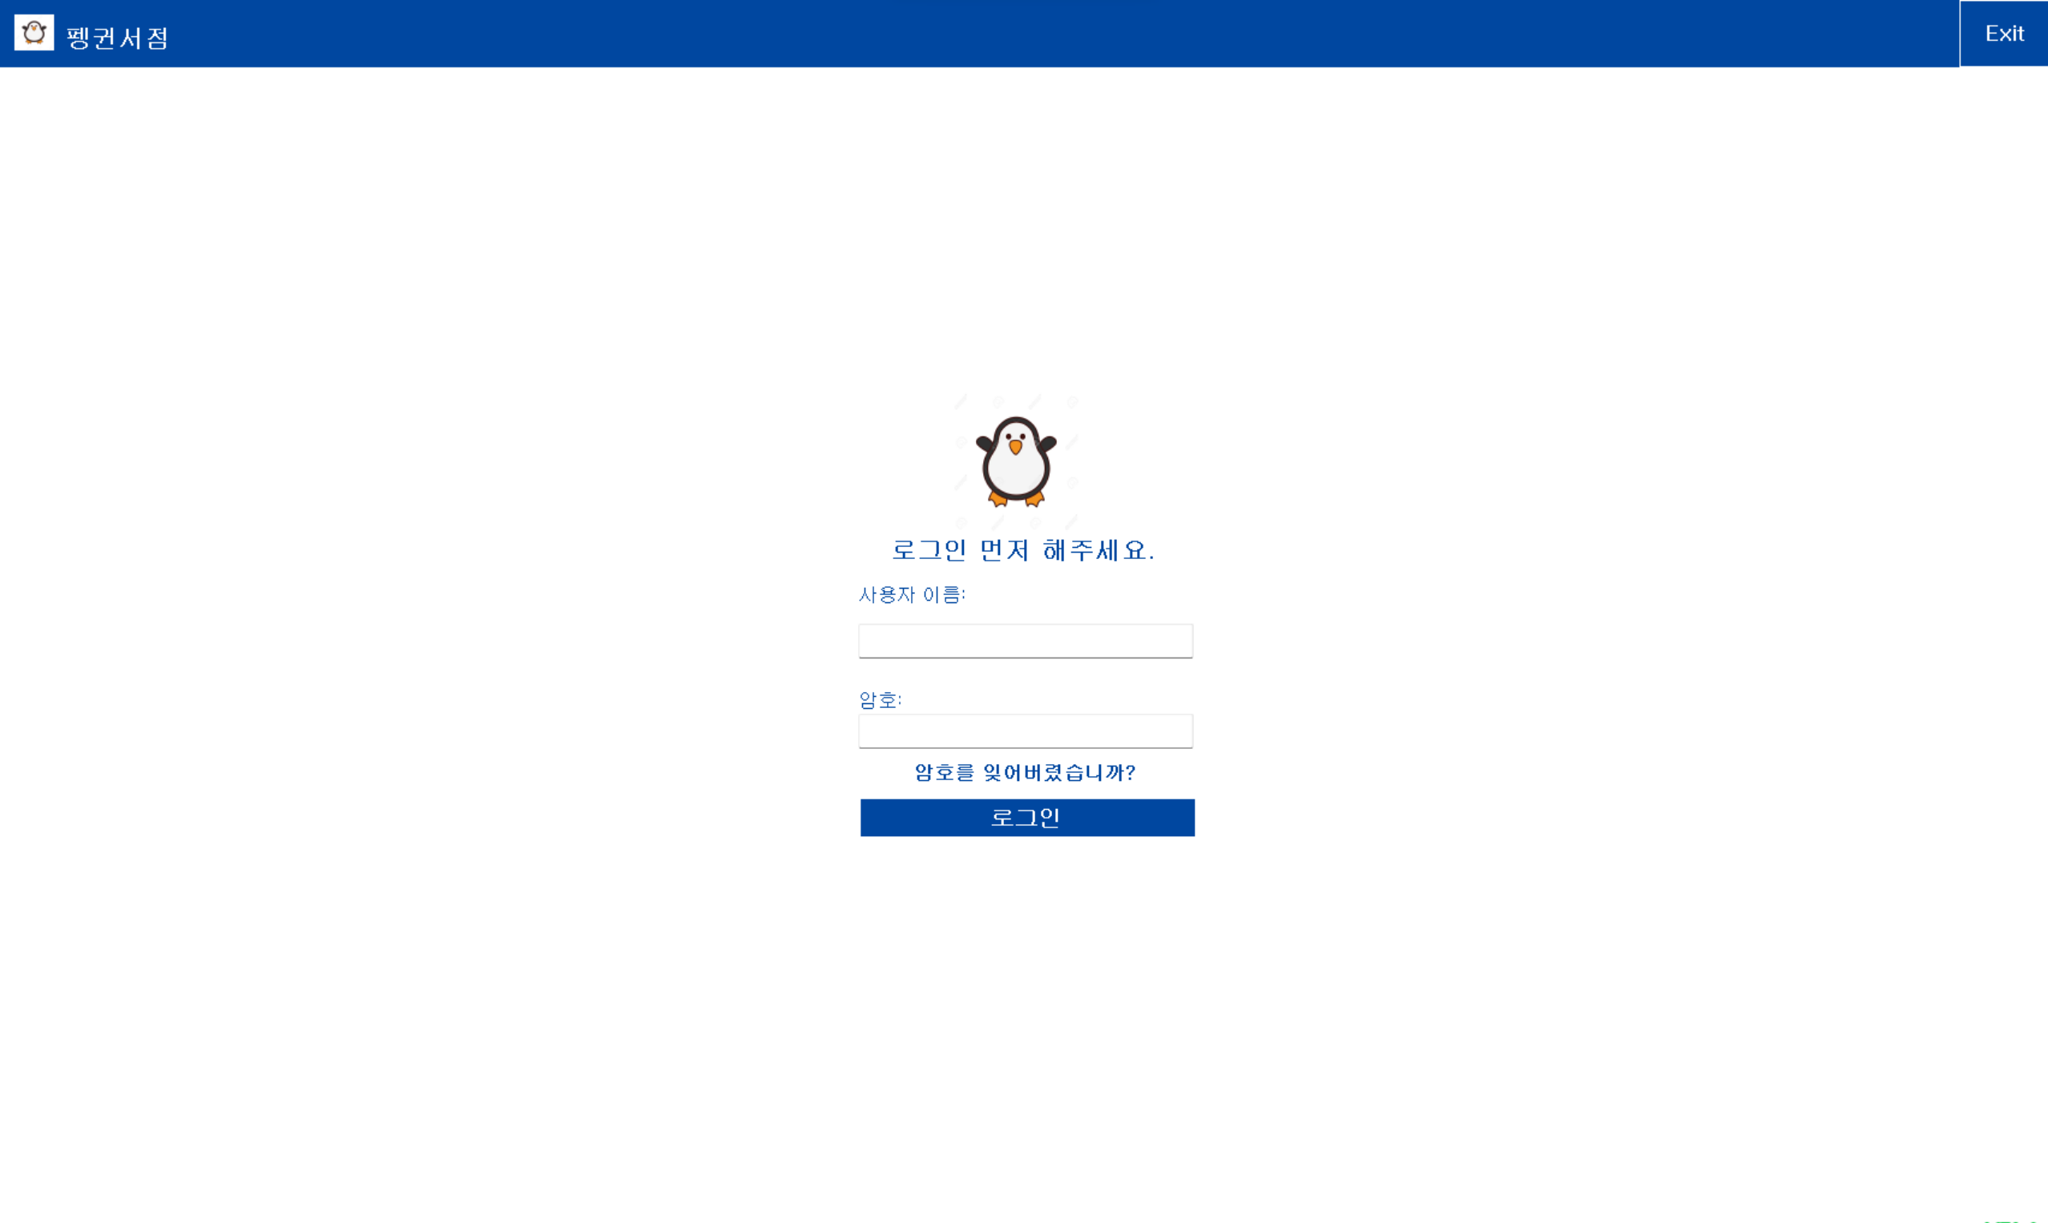
◎원본

Slide 4

◎원본 (구현동영상)

Slide 5
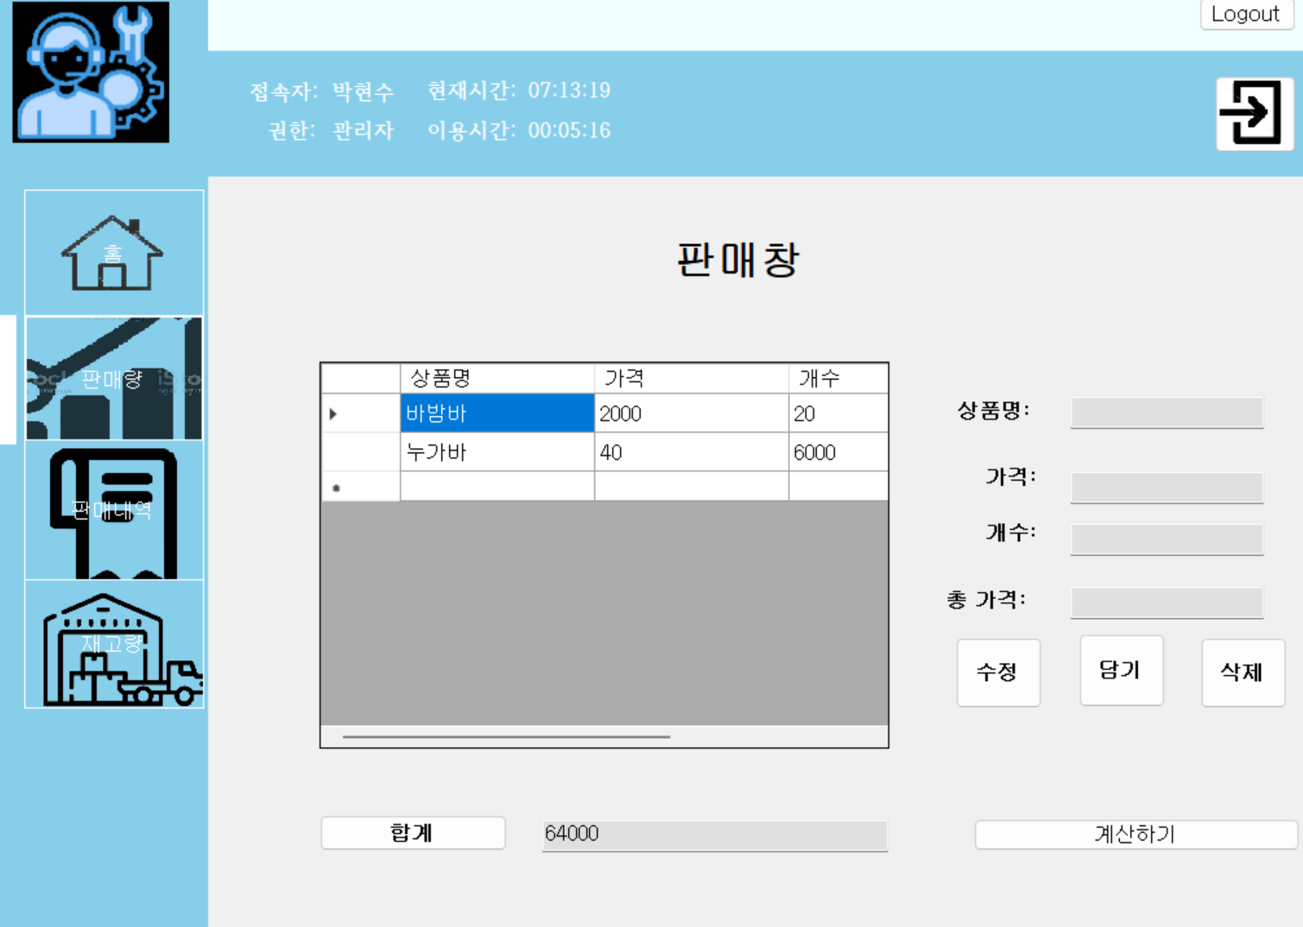
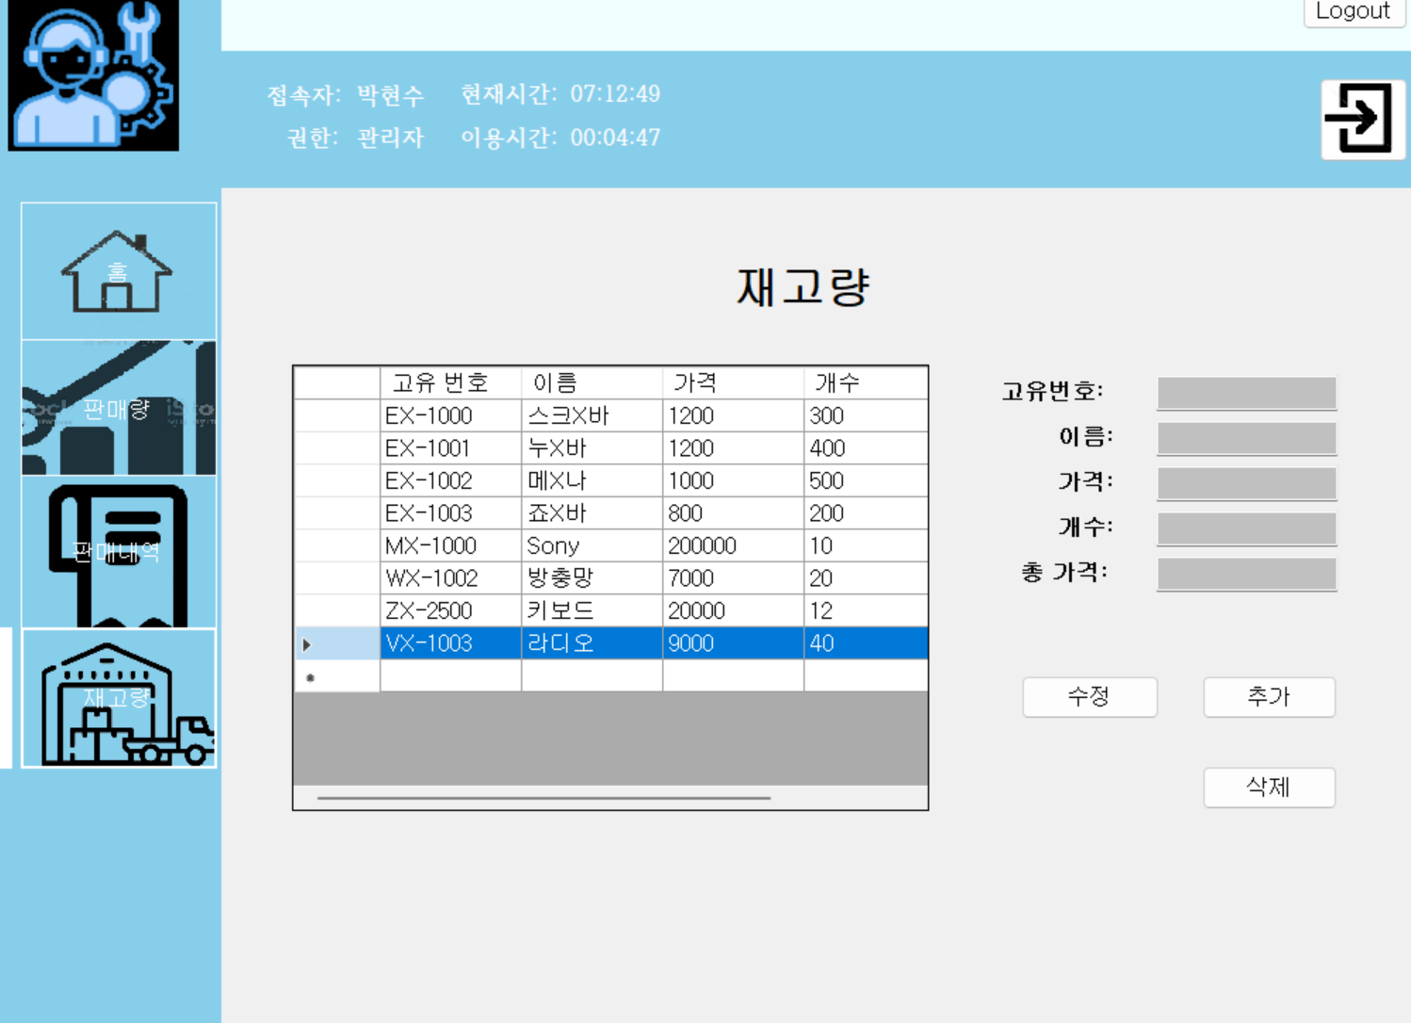
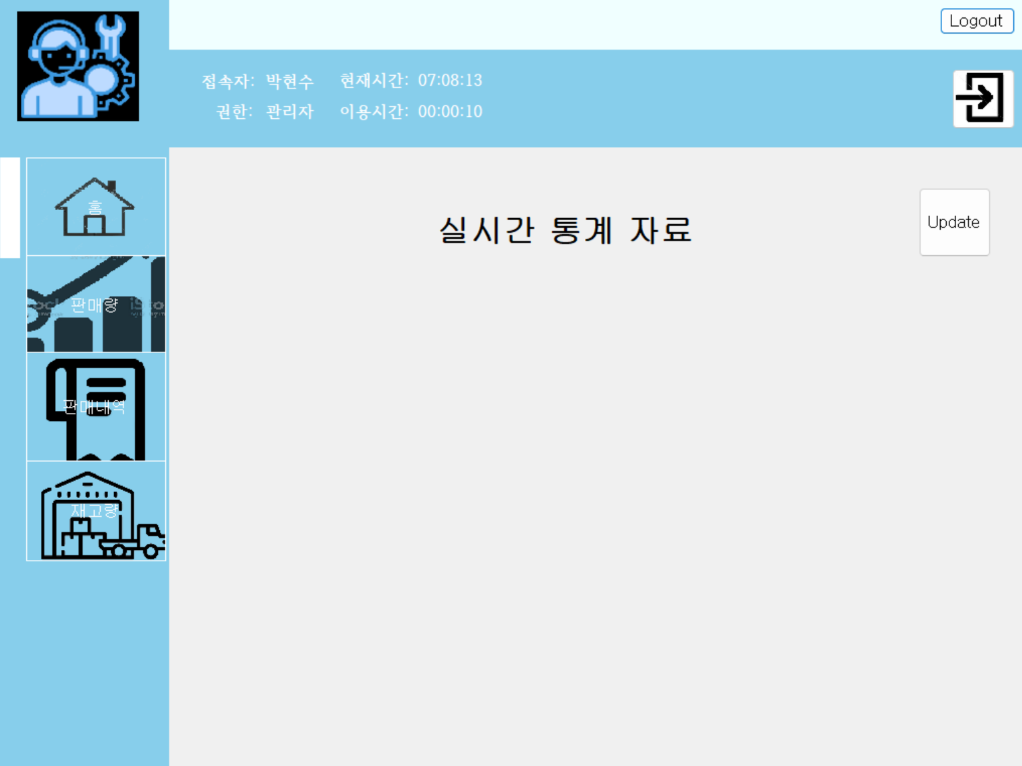
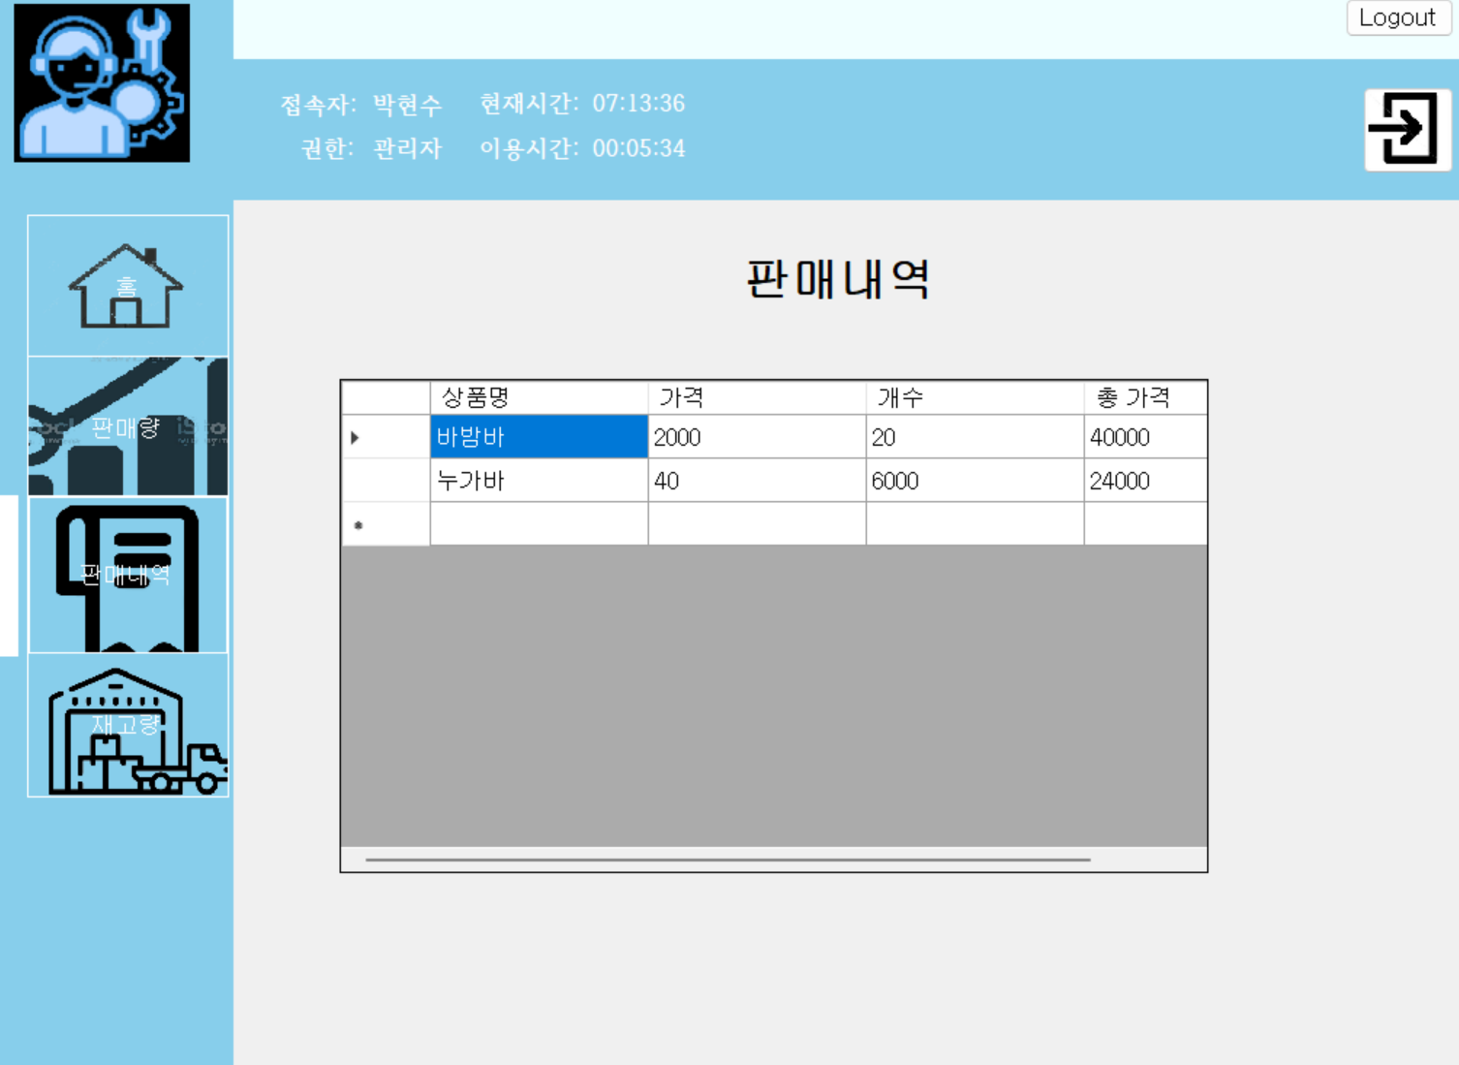
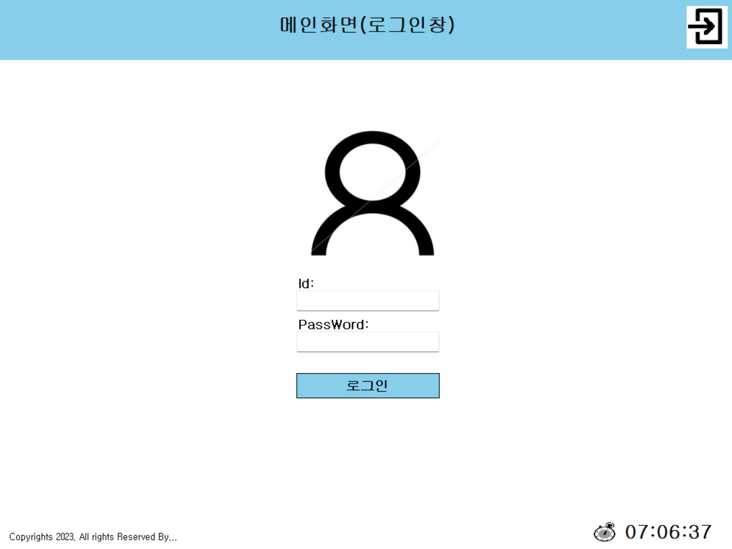
◎Upgrade(큰틀)

Slide 6
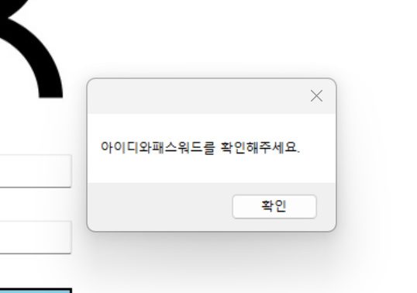
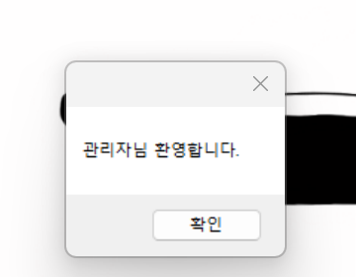
◎Upgrade(로그인화면)

Slide 7
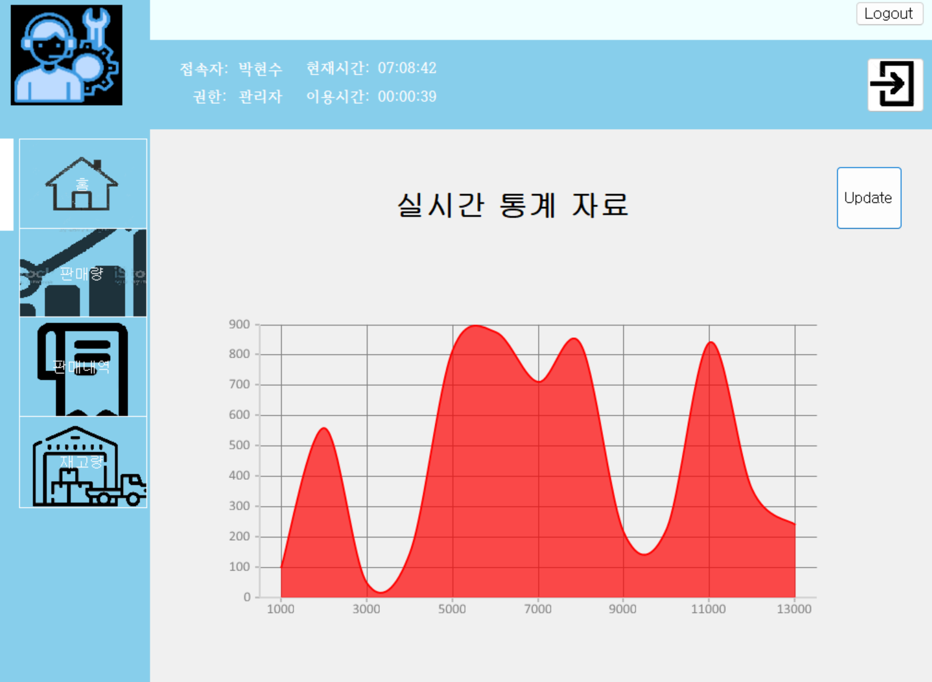
◎Upgrade(메인화면)

Slide 8
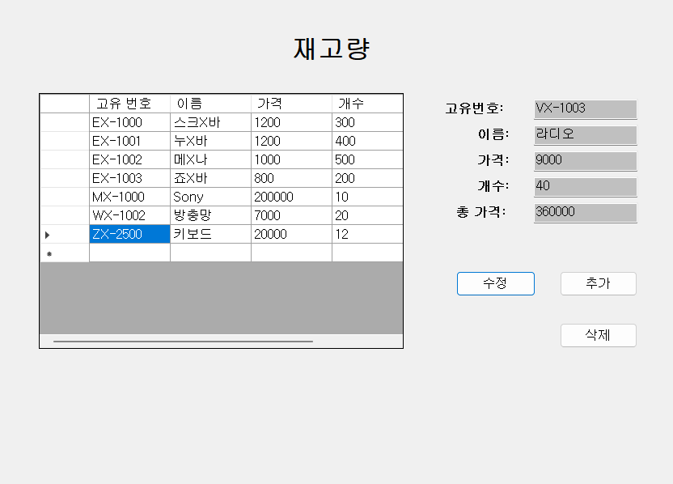
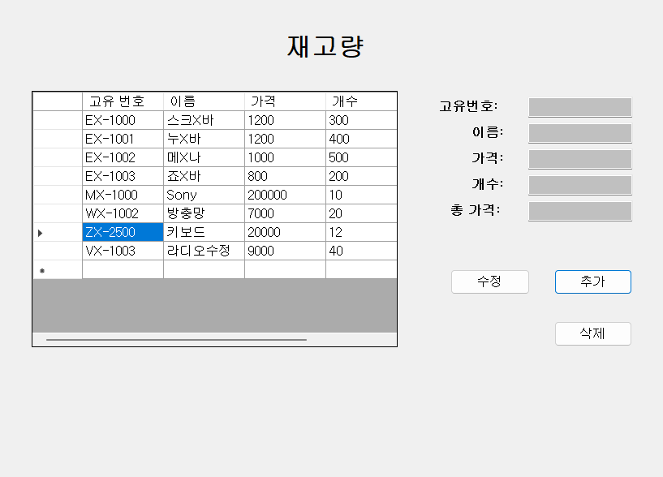
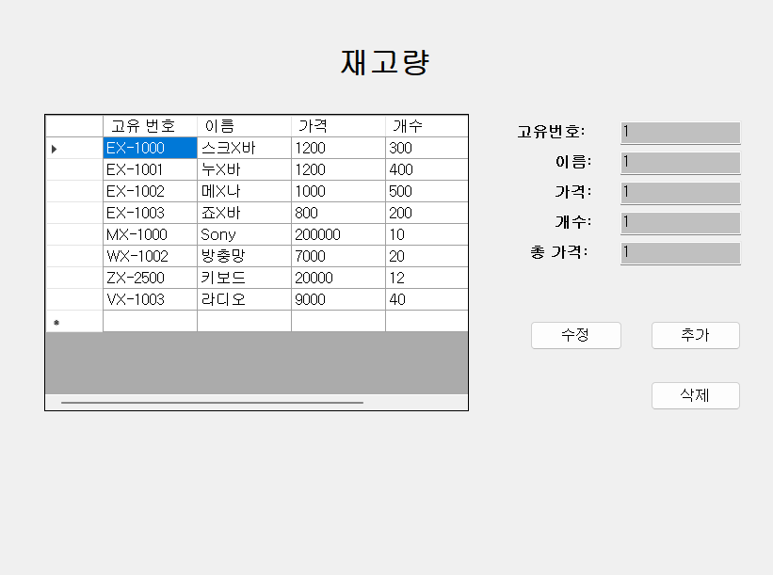
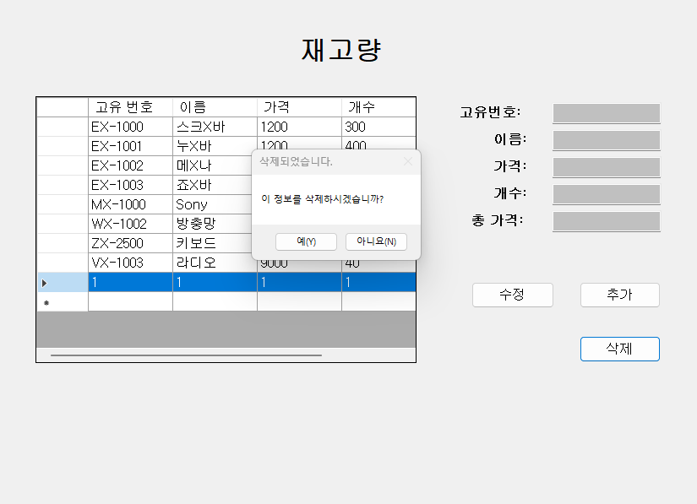
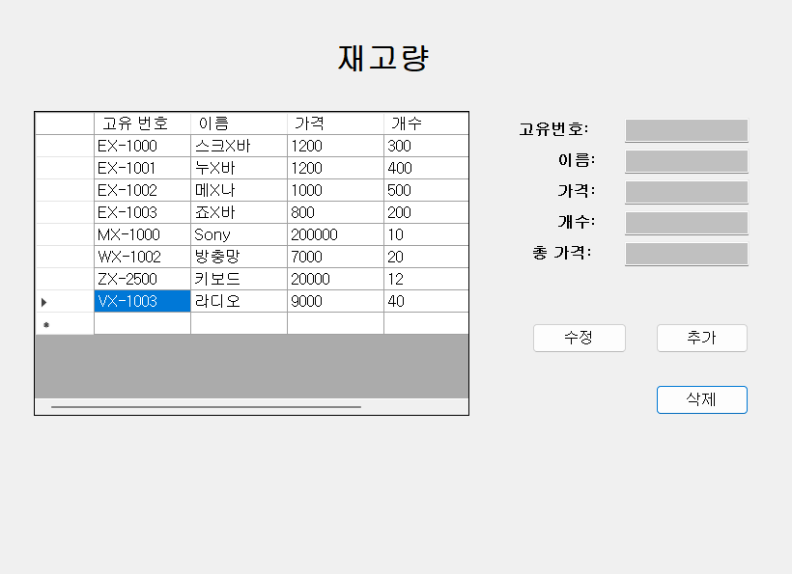
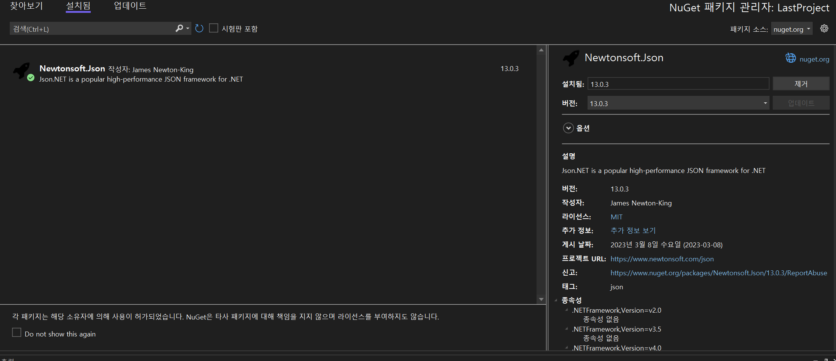
◎Upgrade(재고량)

Slide 9
◎Upgrade(판매창&판매내역)

Slide 10
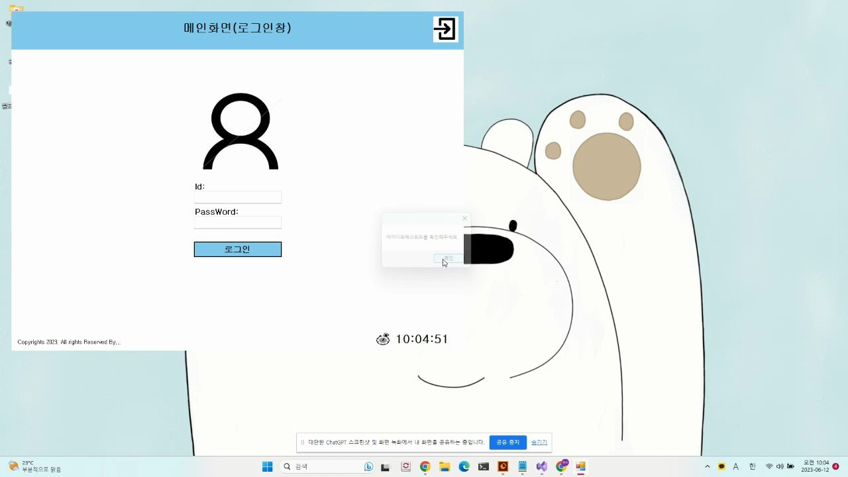
◎Upgrade(사용or사용영상)

Slide 11
◎출처
◎github:https://github.com/Korcp
◎원본소스: https://www.youtube.com/watch?v=Ncq9eAZnN4A&list=PLKTPWN1sf0hV2AqTMUWw_1WFJYiDZbZRn&index=7
: https://www.youtube.com/watch?v=wzeOqp1gQeo&list=PLKTPWN1sf0hV2AqTMUWw_1WFJYiDZbZRn&index=3
: https://www.youtube.com/watch?v=zTg01N3tpYc&list=PLKTPWN1sf0hV2AqTMUWw_1WFJYiDZbZRn&index=2
◎그림: https://www.google.com/url?sa=i&url=https%3A%2F%2Fwww.flaticon.com%2Fkr%2Ffree-icon%2Fstock_5827858&psig=AOvVaw3wajSqyjzJuf1R6QEB99lw&ust=1686615287207000&source=images&cd=vfe&ved=0CBEQjRxqFwoTCLiPo9q5vP8CFQAAAAAdAAAAABAE
https://www.google.com/url?sa=i&url=https%3A%2F%2Fwww.istockphoto.com%2Fkr%2F%25EB%25B2%25A1%25ED%2584%25B0%2F%25EB%25A7%25A4%25EC%25B6%259C-%25EC%2584%25B1%25EC%259E%25A5-%25EC%2595%2584%25EC%259D%25B4%25EC%25BD%2598-gm1086548888-291521428&psig=AOvVaw2V0tWU6Bu9li8yymEAgbWg&ust=1686615334649000&source=images&cd=vfe&ved=0CBEQjRxqFwoTCMCD7_C5vP8CFQAAAAAdAAAAABAE
https://cdn-icons-png.flaticon.com/512/6340/6340749.png
https://cdn-icons-png.flaticon.com/512/63/63988.png
https://previews.123rf.com/images/vectorplus/vectorplus1602/vectorplus160200110/51550285-%ED%9D%B0%EC%83%89-%EB%B0%B0%EA%B2%BD%EC%97%90-%ED%99%88-%EC%95%84%EC%9D%B4%EC%BD%98%EC%9E%85%EB%8B%88%EB%8B%A4-%EB%B2%A1%ED%84%B0-%EC%9D%BC%EB%9F%AC%EC%8A%A4%ED%8A%B8-%EB%A0%88%EC%9D%B4-%EC%85%98.jpg
https://cdn-icons-png.flaticon.com/512/2304/2304226.png
https://search.pstatic.net/common/?src=http%3A%2F%2Fblogfiles.naver.net%2FMjAyMjA5MjZfMTM0%2FMDAxNjY0MTY3MTgwMTc0.IWHF569NAD9FEmufeuznBGVfvKXam6mha60AX75s9T8g.7p_btVwwHz3FUwbUwqE2UgSND8TG2VCssm8w93HAJRwg.PNG.pt-conects%2Fimage_2.png&type=sc960_832
https://cdn.inflearn.com/public/files/courses/326998/e8bad62d-d39a-4368-a43c-5595e3b09133/c-sharp.png

Slide 12
감사합니다~

